Slide 1
CoG User Interface (UI), Metadata and Search
Task |  | R&D Area
1.1 |  | Data Management
1.2 |  | User Interface and Search
1.3 |  | Hardware & Network
1.4 |  | Data Transfer
1.5 |  | Installation (Containerized)
1.6 |  | Authentication & Authorization
1.7 |  | Federation
1.8 |  | Quality Control & Assurance
1.9 |  | Replication
1.10 |  | Distributed Search
1.11 |  | Metrics
1.12 |  | User Notification
1.13 |  | Long-tail Publication
1.14 |  | Distributed Computation
1.15 |  | Data Citation
2.1 |  | Provenance Capture
2.2 |  | Workflow
2.3 |  | Dynamic Resources
2.4 |  | In situ Analysis
2.5 |  | Machine Learning
2.6 |  | UQ
2.7 |  | Analytical Modeling
2.8 |  | Mobile Apps
Current capability status:
 | Usable
 | Prototype
 | Research activity
Luca Cinquini
NASA Jet Propulsion Laboratory
2017 Triennial Project Review, Potomac, MD
June 8 – 9, 2017

Slide 2
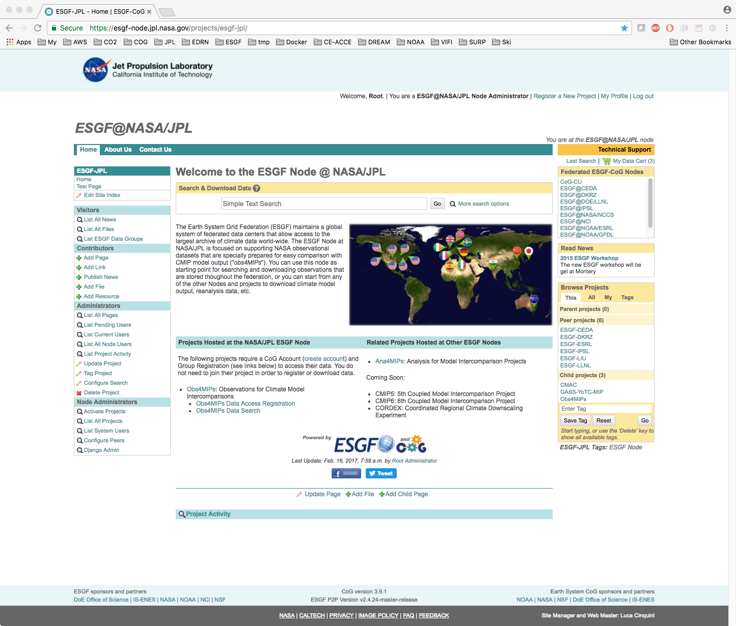
CoG Introduction
CoG is a Django-based web application that is the main User Interface to a full-featured ESGF Node
Historically developed with NOAA funding as a web-based platform for formalizing and sharing the governance of scientific projects, later evolved to include more and more ESGF functionality and was adopted as a replacement for the old web front-end
Now CoG is developed collaboratively with contributions from JPL, ANL, DKRZ
ESGF CoG home page @ NASA.JPL

Slide 3
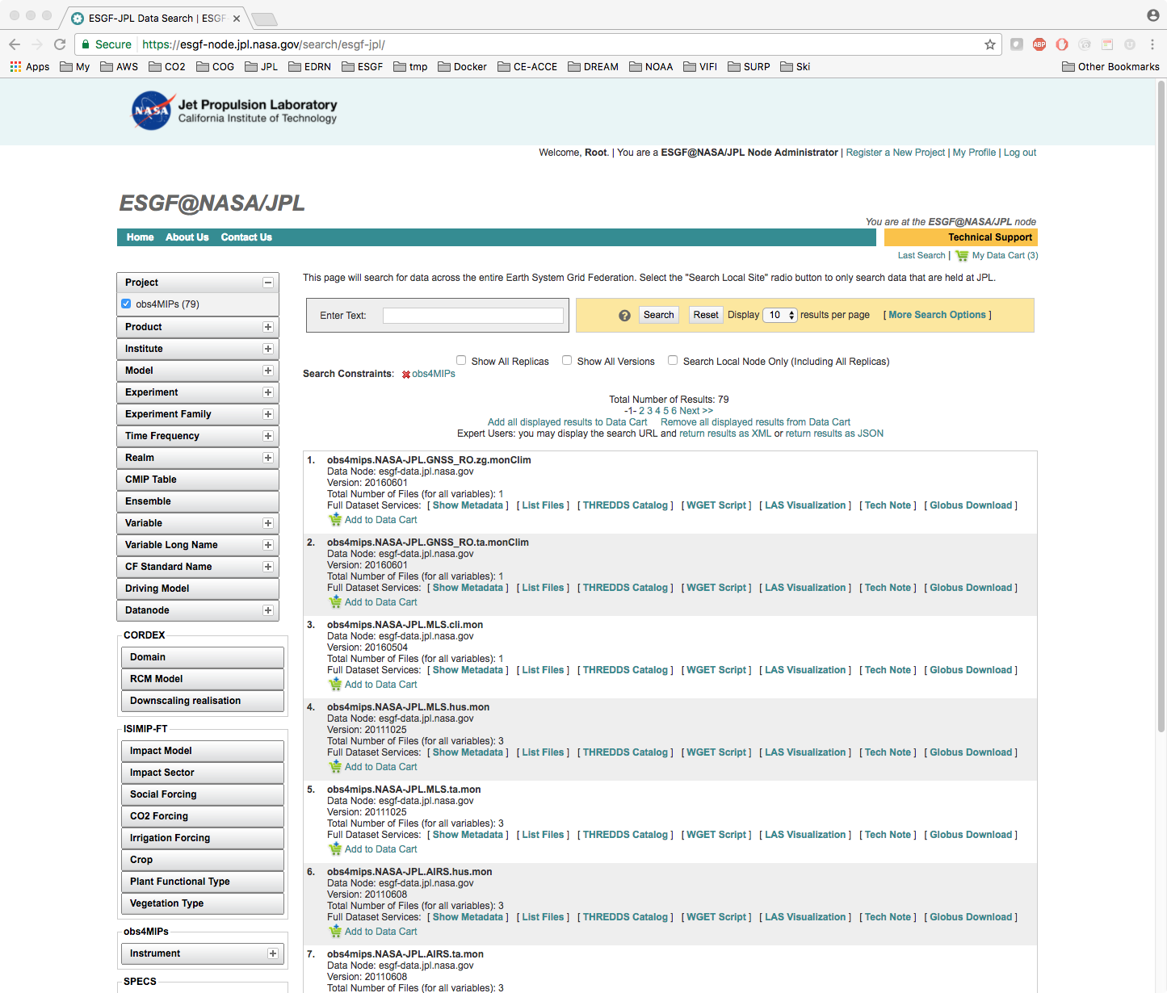
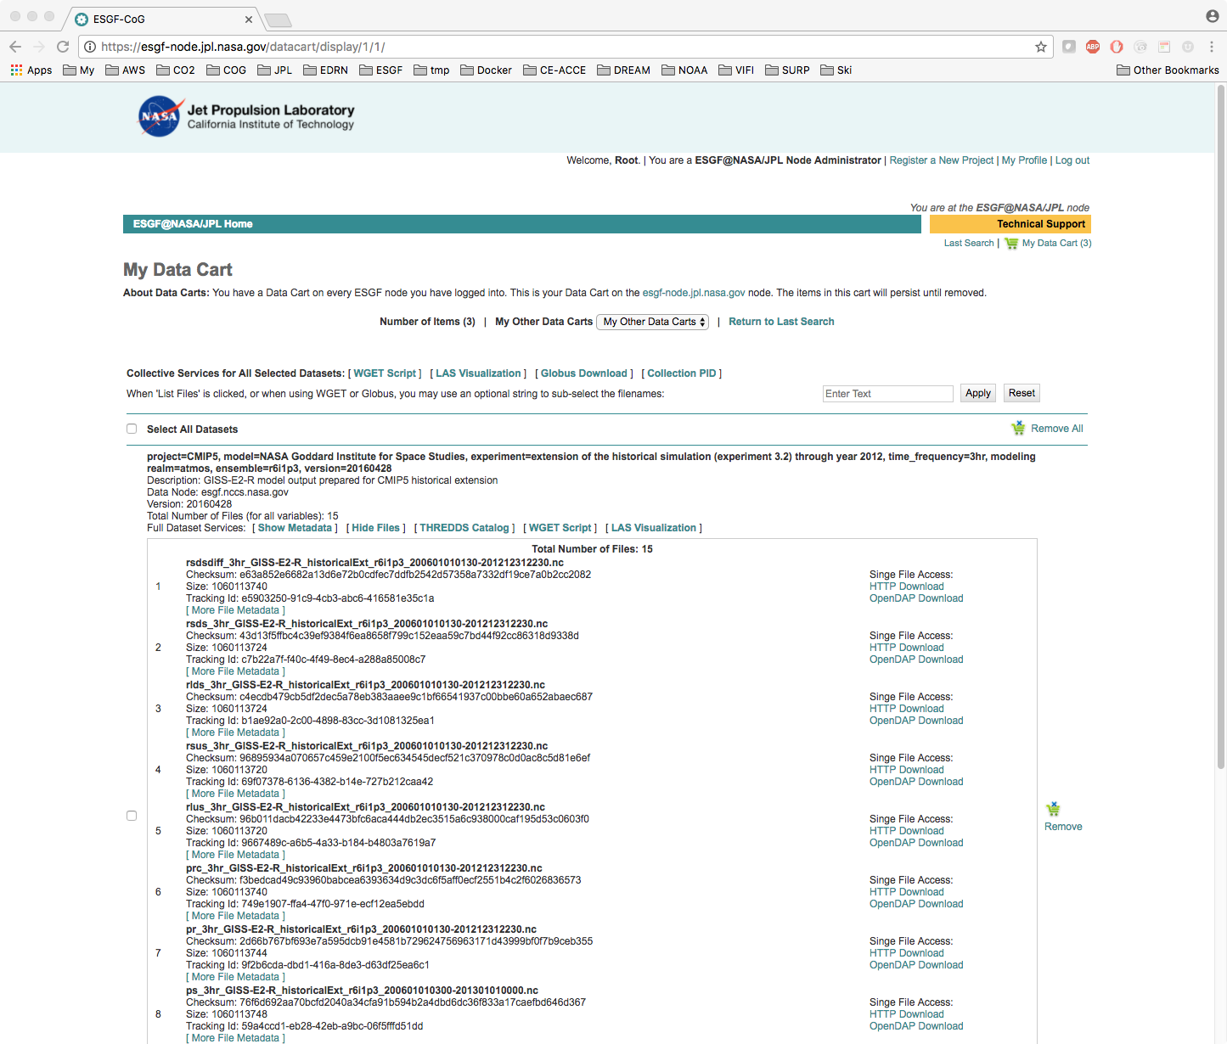
CoG Functionality (1)
User interface to back-end search services
Free text and faceted searches
Data cart to store results and invoke data services
Integration with PID and citation services
Integration with Obs4MIPs quality indicators
Integration with ES-DOC metadata services
Admin interface to configure search options and back-end services
Search results
User data cart

Slide 4
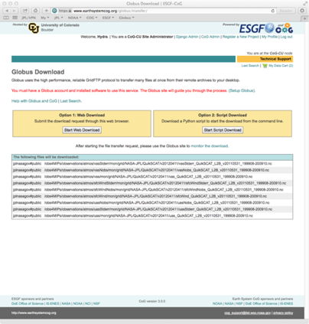
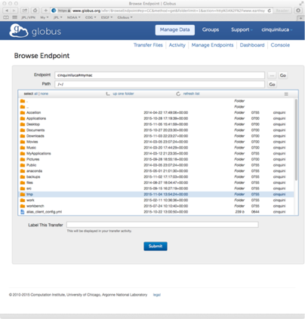
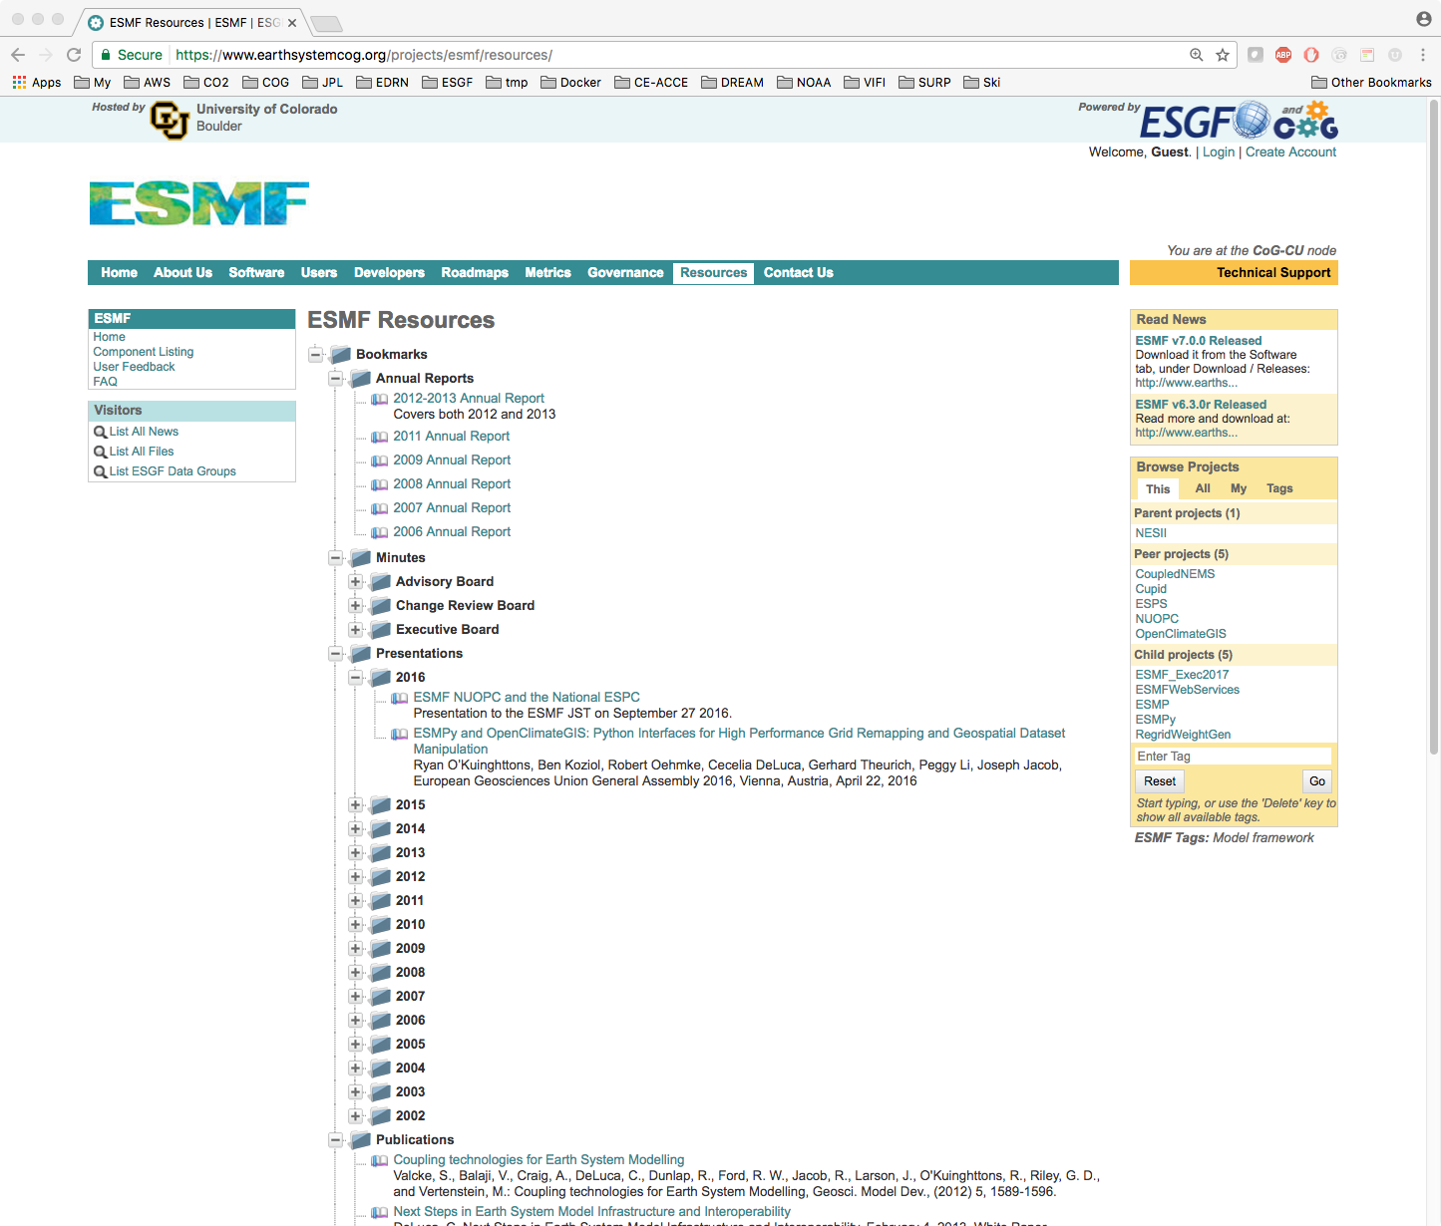
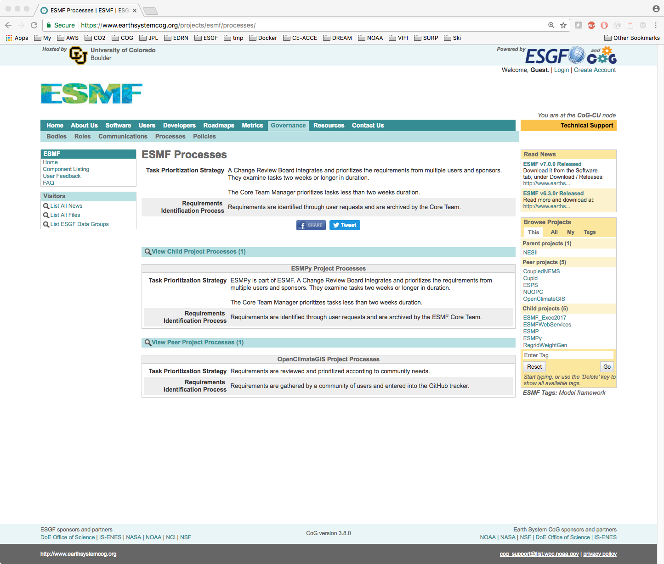
CoG Functionality (2)
Globus data download
User interface for data downloads
Single HTTP downloads
Data selection for wget script generation
Integrated with Globus
Scientific collaboration environment
Wiki
Web repository for digital resources
Template pages for describing project governance
Admin interface to configure project options and user membership
ESMF policies
ESMF resources

Slide 5
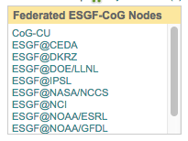
CoG Federation
ESGF Nodes browser
All ESGF CoG web portals are federated with each other
Each CoG is aware of its “peers”
Scientific projects are exchanged and hyperlinked across portals
Basic user information (registration site, project membership) is exchanged
Leveraging other ESGF federation capabilities: Single Sign On and federated searches
Projects browser
CoG P2P information exchange

Slide 6

CoG Shortcomings
Parts of the software stack are based on older technology which is no longer maintained, and is likely to become insecure in the future
Javascript framework (YUI 2.9)
Wiki editor
Not very modular: each CoG installation must include all of the supported functionality (search, download, wiki, governance, …)...
...consequently, it is more difficult to include new functionality: developers must work with the full software package
Lack of an automatic testing framework

Slide 7
CoG Proposed Work (1)
With this proposal, we intend to address the above shortcomings and evolve CoG into a UI framework that can be used by ESGF and other BER projects for the long term future. Specifically we plan to:
Modularize CoG into a pluggable architecture of CoGs (“Composable GUIs”)
Each area of functionality is encapsulated into a standalone module
Will enable easy addition of new functionality modules:
Example: front-end for CWT services
Example: display for data provenance
Example: data re-gridding interface for satellite data
Governance
Download
Search

Slide 8
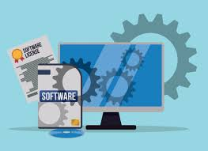

CoG Proposed Work (2)
Replace some of the underlying older technology
Replace YUI with Node.js
Replace wiki editor with some new open source solution
Develop an extensive testing framework
Selenium for front-end browser tests
Python test suite for back-end services
Strategy: not a re-write from scratch, rather an incremental process of modularization and integration
Target time frame: 3 years
Estimated FTEs: 0.75 developer + 0.1 supervisor

Slide 9

Metadata and Search Overview
ESGF employs a state-of-the-art architecture based on Solr, that enables searching a federated system of distributed metadata archives which are administered independently
A client can issue a search request to any ESGF node, and will be presented with a consistent set of results that span the whole federation
Solr is an open source high performance search engine used by many public and commercial applications
ESGF uses advanced Solr features such as shard replication and distributed searches

Slide 10
Metadata and Search Architecture
Each ESGF node operates 2 core Solr instances:
“Master” Solr, where the data are published (aka indexed)
“Slave” Solr, that replicates the Master Solr and is used by clients for searching
Separation of read/write operations increases performance
Additionally, each ESGF node maintains a list of all other nodes in the federation. A client search request is automatically distributed to all nodes, then the results are aggregated together
Optionally, each ESGF node can replicate some or all of the remote indexes, so that a search request is always resolved locally, for increased performance

Slide 11
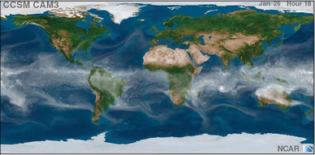
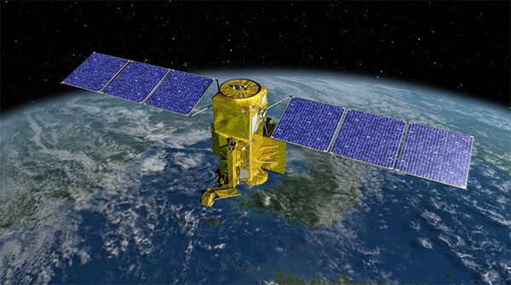

Metadata and Search New Requirements
In order to remain a viable solution for the medium/long term future, the ESGF search services must be upgraded to address several new requirements:
Scalability: it is estimated that the total volume of climate data will grow 100 times in the next 5-10 years. ESGF alone will have to manage:
CMIP6 data archive: ~20PB of replicated distributed data, compressed (~40 PB uncompressed)
Tens of new MIP projects
New observational products (higher resolution grids, swaths, in-situ)
Performance: maintain or improve performance despite increases in data volumes, number of users, number of nodes
Resiliency: global searches must not degrade due to temporary hardware/network failures
Generality: application to other BER-relevant science domains (hydrology, biology, etc.)
Operations: search services must be easy to install, configure and scale on any platform (laptop, in-premise cluster, cloud)

Slide 12
Metadata and Search Proposed Work (1)
Design and implement a new ESGF search architecture based on Solr Cloud – the next generation Solr architecture for handling Big Data
Automatic distributed indexing and searching across shards
Configurable number of replica shards provide resiliency, automatic failover
Built-in load balancing and high availability
Capable of handling billions of records
Prototype architecture: “super nodes” use “repeaters” to harvest metadata from peer nodes into internal Solr Cloud cluster

Slide 13
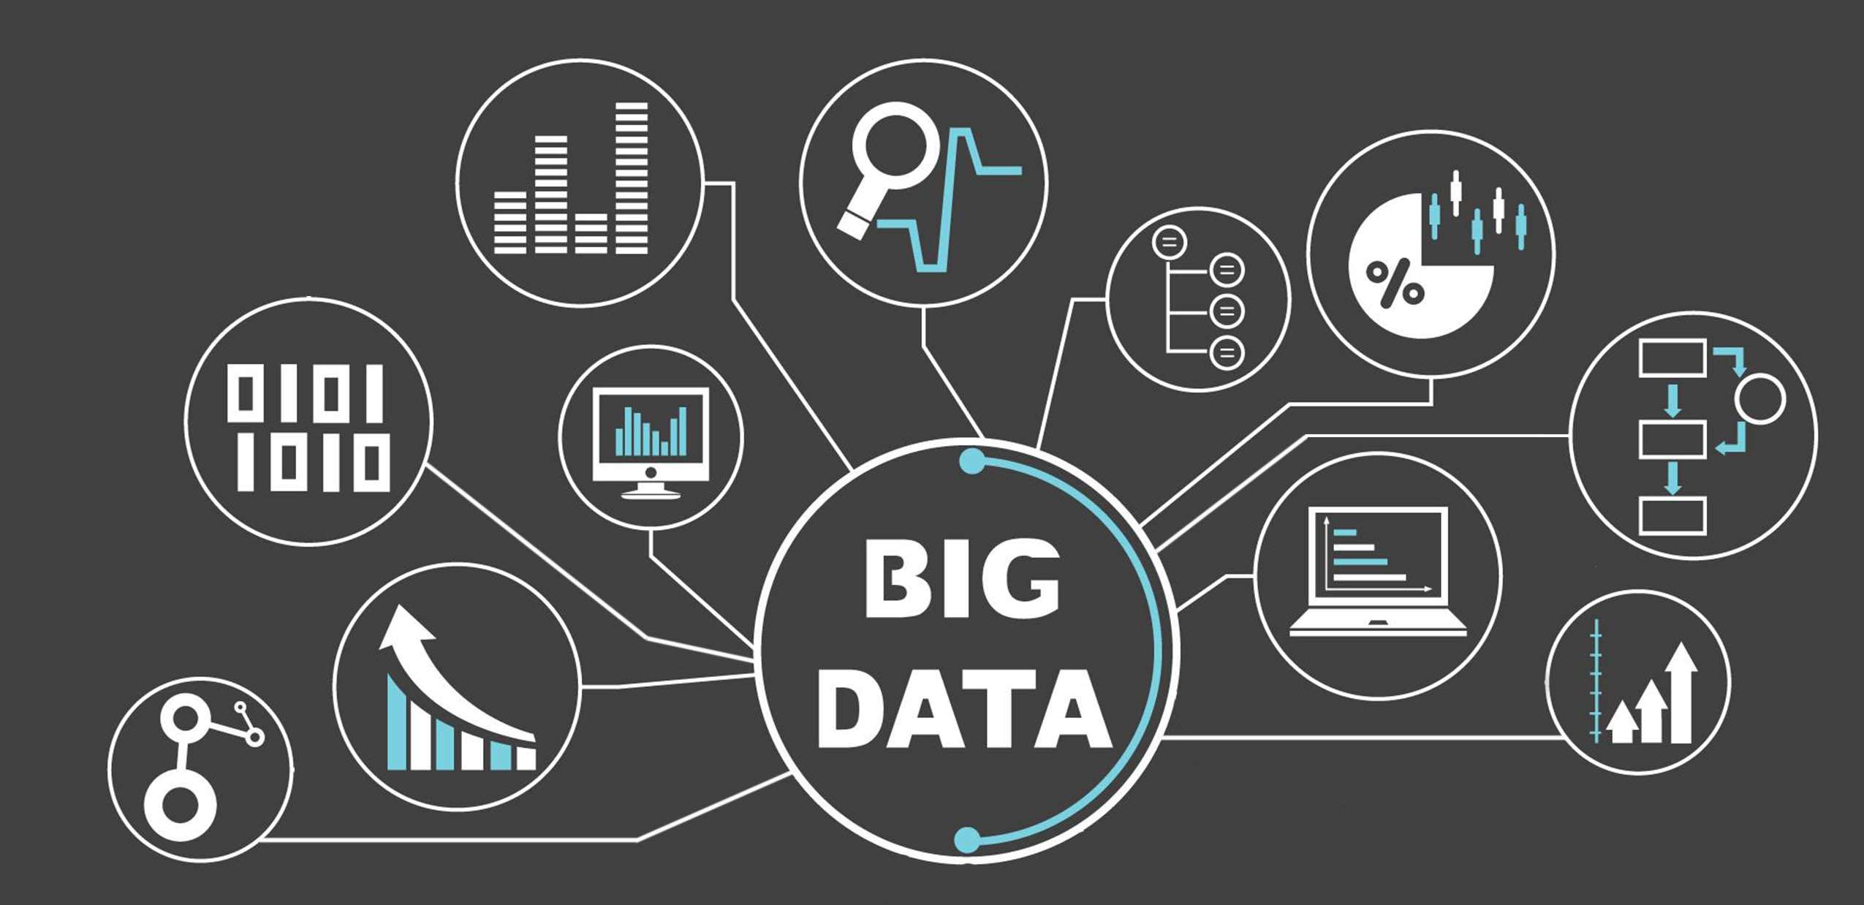
Metadata and Search Proposed Work (2)
Package and distribute the ESGF search services framework for easy and scalable deployment on the Cloud
Maintain as a versioned Docker image
Provide configuration for standard and Solr-Cloud deployments
Operate infrastructure on Amazon Cloud
Provide extensive documentation for administrators
Generalize the underlying ESGF search architecture to be applicable to other scientific domains
Architecture for pluggable domain specific schemas and APIs
Demonstrate application to a few selected science domains
Track new Solr releases and upgrade the ESGF infrastructure accordingly
Research and prototype other Big Data search technologies for selected use cases
MongoDB, Cassandra, Accumulo, …
Start inter-operability study with other U.S. agencies (NASA, NOAA, USGS, ...)
Harvest other metadata holdings and make them available to ESGF searches, eventually redirecting to the source site
Estimated FTE: 0.5 developer, 0.1 supervisor

Slide 14



Questions

